Slide 1
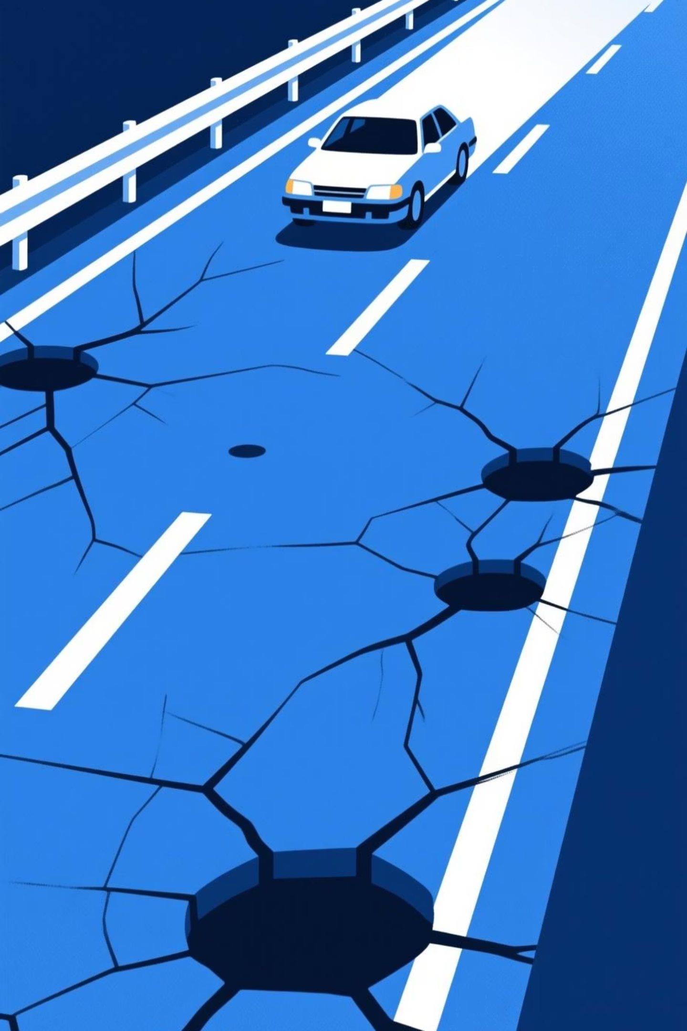
Road Surface Condition Classification using CNN
Course / Context: C417 – Neural Networks.
Supervisor: Dr. Hend Dawood.
Team: Youssef Ahmed Nour El‑Dien, Mina Lotfy Fekry, Menna Allah Hassan Youssef, Mohammed Ragab Mohammed, Amr Elbaroudy.

Slide 2





The Problem
Road surface degradation (cracks, potholes, rutting) directly affects vehicle safety, ride comfort, and maintenance costs.
Manual visual inspection is slow, subjective, and cannot scale to continuous monitoring of large road networks.
For autonomous and advanced driver-assistance systems, there is a need for real-time, on-board classification of road condition into Good, Poor, and Very Poor so that vehicles and agencies can proactively adapt speed, routing, and maintenance priorities.

Slide 3

Dataset & Preprocessing
Input: RGB road images labeled into three classes: good, poor, verypoor.
Data augmentation on the training set:
Brightness and contrast variation.
Resizing & Normalization: All images are resized to 224×224 pixels and normalized to a consistent input shape of 224,224,3.
Random rotation.
Horizontal flipping. These augmentations increase data diversity and help reduce overfitting.
Dataset split: 80% Training, 10% Validation, 10% Test to allow unbiased generalization evaluation.

Slide 4

Critical Challenge & Solution
Initial Ambiguity
Reduced Accuracy
Initial dataset classes were Good, Satisfactory, Poor, and Very Poor, but Satisfactory and Poor were visually very similar, causing ambiguous and inconsistent labels.
This ambiguity reduced model accuracy because the CNN could not reliably learn discriminative features between Satisfactory and Poor.
Data Engineering Solution
Improved Performance
Data engineering solution: merge Satisfactory into Poor, yielding three clearer classes: Good, Poor, Very Poor.
After merging, label noise decreased and the model achieved more stable training dynamics and higher overall performance.

Slide 5
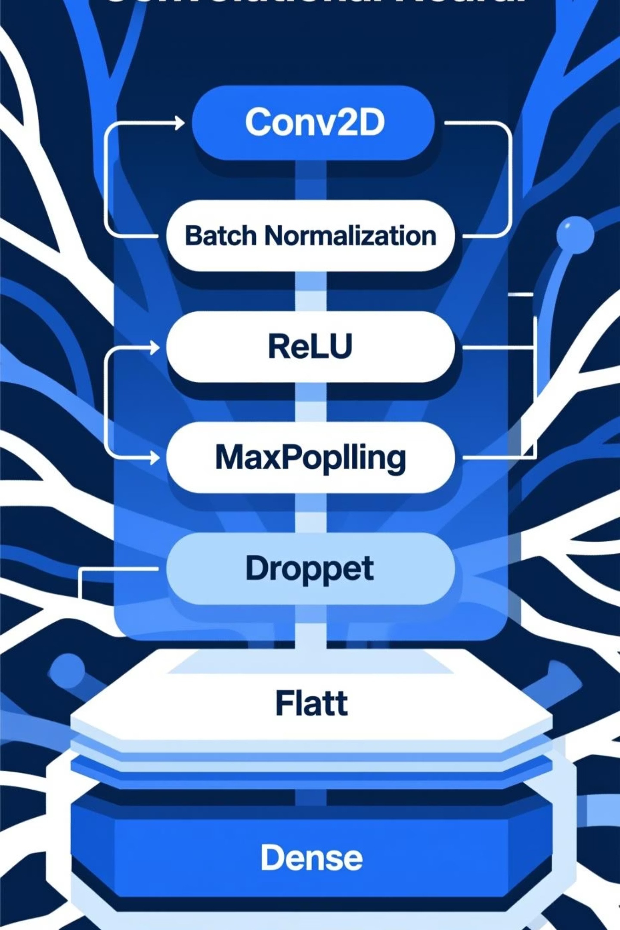
Model Architecture (CNN)
Framework: TensorFlow/Keras custom Convolutional Neural Network.
Convolutional blocks:
Sequential Conv2D layers with filters 32, 64, 128, 256.
Each Conv layer followed by Batch Normalization and ReLU activation to stabilize and accelerate learning.
MaxPooling after each block to progressively down-sample spatial dimensions while retaining salient features.
Regularization: Dropout layers inserted after convolutional blocks and dense layers to reduce co-adaptation and overfitting.
Classifier head: Flatten → Dense layers with ReLU → final Dense layer with softmax activation over 3 classes.

Slide 6




Training Strategy
Optimizer: Adam, chosen for its adaptive learning rate and robust convergence on CNN-based image tasks.
Callbacks:
ReduceLROnPlateau lowers the learning rate when validation loss plateaus, enabling finer convergence.
Loss function: Categorical Cross-Entropy for multi-class classification with softmax outputs.
EarlyStopping monitors validation accuracy and stops training when it no longer improves, saving the best-performing model weights.
Key hyperparameters: batch size 32, up to 40 epochs with callbacks.

Slide 7

Key Results
98%
1.00
0.99
Test Accuracy
Good Class Precision
Poor Class Recall
on the held-out test set, indicating strong generalization to unseen road images.
Precision and recall are high for all three classes; for example, Good class precision reaches 1.00 and Poor class recall reaches 0.99, showing that the model rarely mislabels good roads and successfully captures nearly all poor roads.
Precision and recall are high for all three classes; for example, Good class precision reaches 1.00 and Poor class recall reaches 0.99, showing that the model rarely mislabels good roads and successfully captures nearly all poor roads.
High and balanced metrics across classes confirm that the data preprocessing (label merge and augmentation) and regularized CNN architecture effectively mitigated overfitting.

Slide 8

Key Results
Accuracy
Precision
Recall
"How often is the model right in general?" If you show the AI 100 pictures of roads, and it correctly identifies the condition (whether Good, Poor, or Very Poor) for 90 of them, its Accuracy is 90%. * In simple terms: It’s the general grade on the test. It tells you how good the model is overall, but it doesn't tell you *where* it is making mistakes.
"When the model claims a road is 'Very Poor', can I trust it?“
Imagine the AI flags 10 roads as "Very Poor." You send a crew out to fix them, but they find that only 6 are actually "Very Poor" (the other 4 were just dirty or wet, but the road was fine).
"Did the model find *all* the 'Very Poor' roads, or did it miss some?"
Imagine there are actually 20 "Very Poor" roads in the entire city. The AI successfully found 10 of them, but it completely missed the other 10 (maybe it thought they were just "Poor" or "Good").
Summary:-
Accuracy: Did it get the right answer? Precision: Did we waste time on false alarms? Recall: Did we miss any dangerous problems?

Slide 9
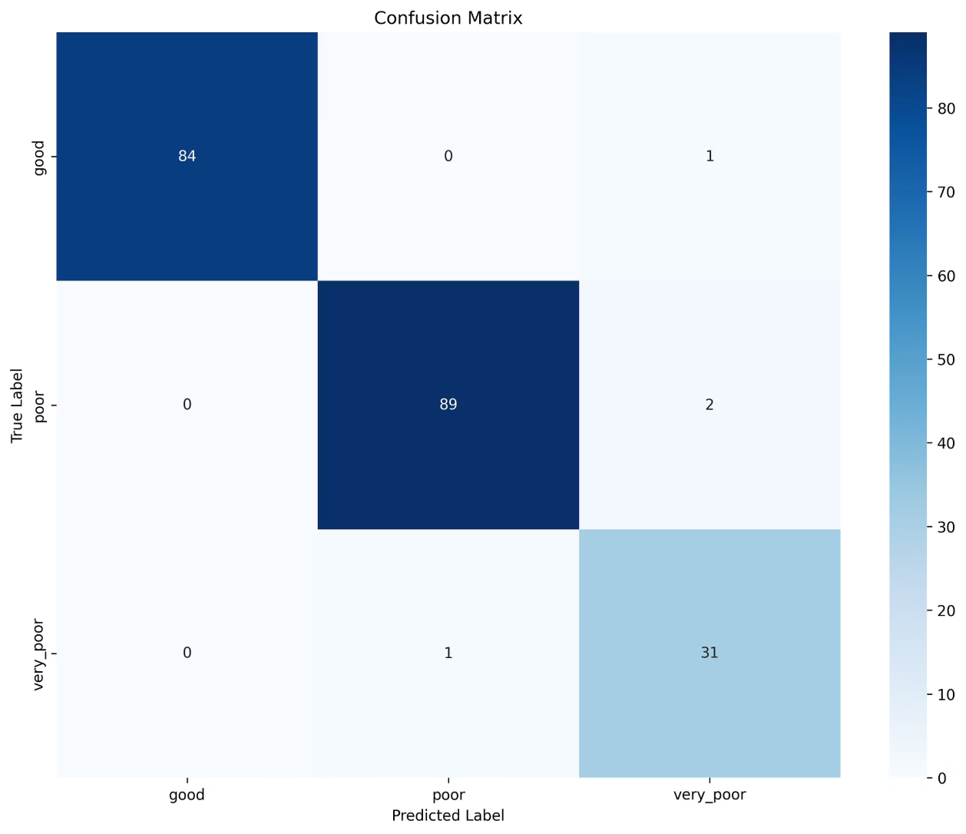
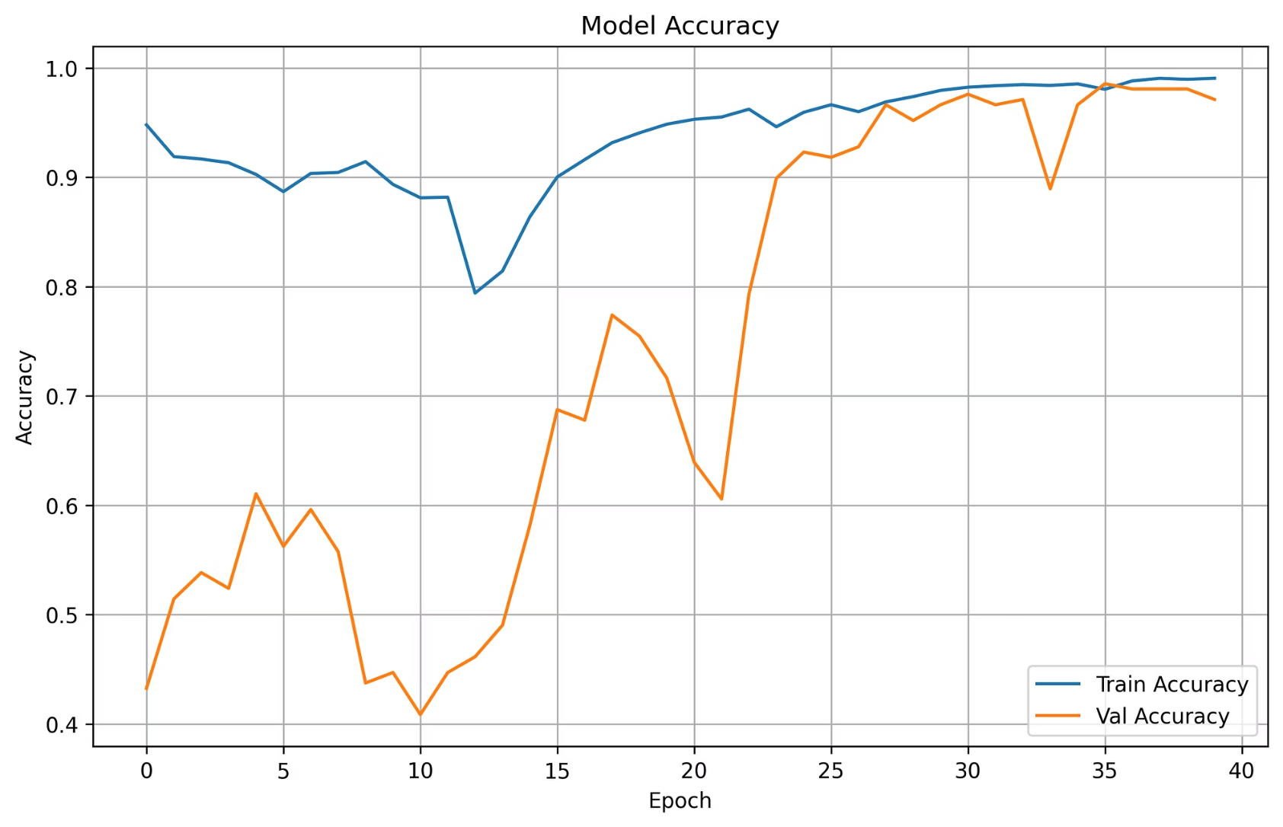

Visual Evidence
Confusion Matrix
Training & Validation Accuracy
High True Positives: The dark blue diagonal squares indicate correct predictions.
Final Accuracy: The model reaches ~98% validation accuracy by Epoch 40.
"Good" Class Accuracy: 84 out of 85 "Good" road images were correctly identified.
Learning Phase (Epochs 0-20): Shows high volatility as the model explores features.
"Poor" Class Accuracy: 89 out of 91 "Poor" road images were correctly identified.
Stabilization (Epochs 25-40): The orange line (Validation) smooths out and tracks closely with the blue line (Training), indicating the model has stopped overfitting and is generalizing well.
Minimal Confusion: Only 4 images total were misclassified out of the entire test set.

Slide 10
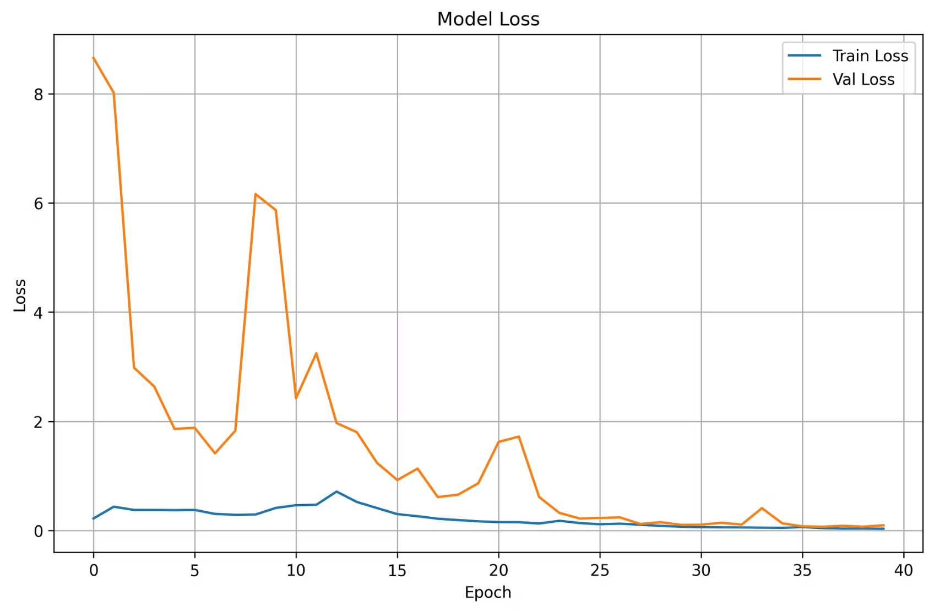
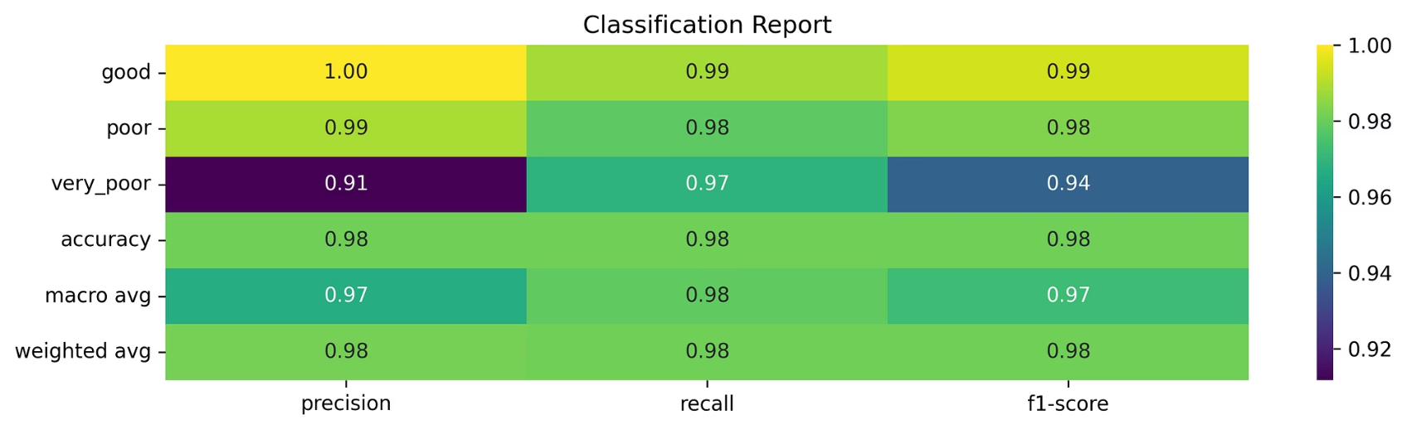



Visual Evidence
Model Loss
Classification Report
Precision: The model is 100% precise when predicting "Good" roads.
Rapid Improvement: Significant drop in validation loss (orange line) after the initial epochs.
Recall: It captures 99% of all actual "Good" roads and 98% of "Poor" roads.
Convergence: Both training and validation loss flatten out near zero after Epoch 25.
Overall F1-Score: An average score of 0.98 across all classes, indicating a perfectly balanced model.
Reliability: The low final loss confirms high confidence in the model's predictions.

Slide 11
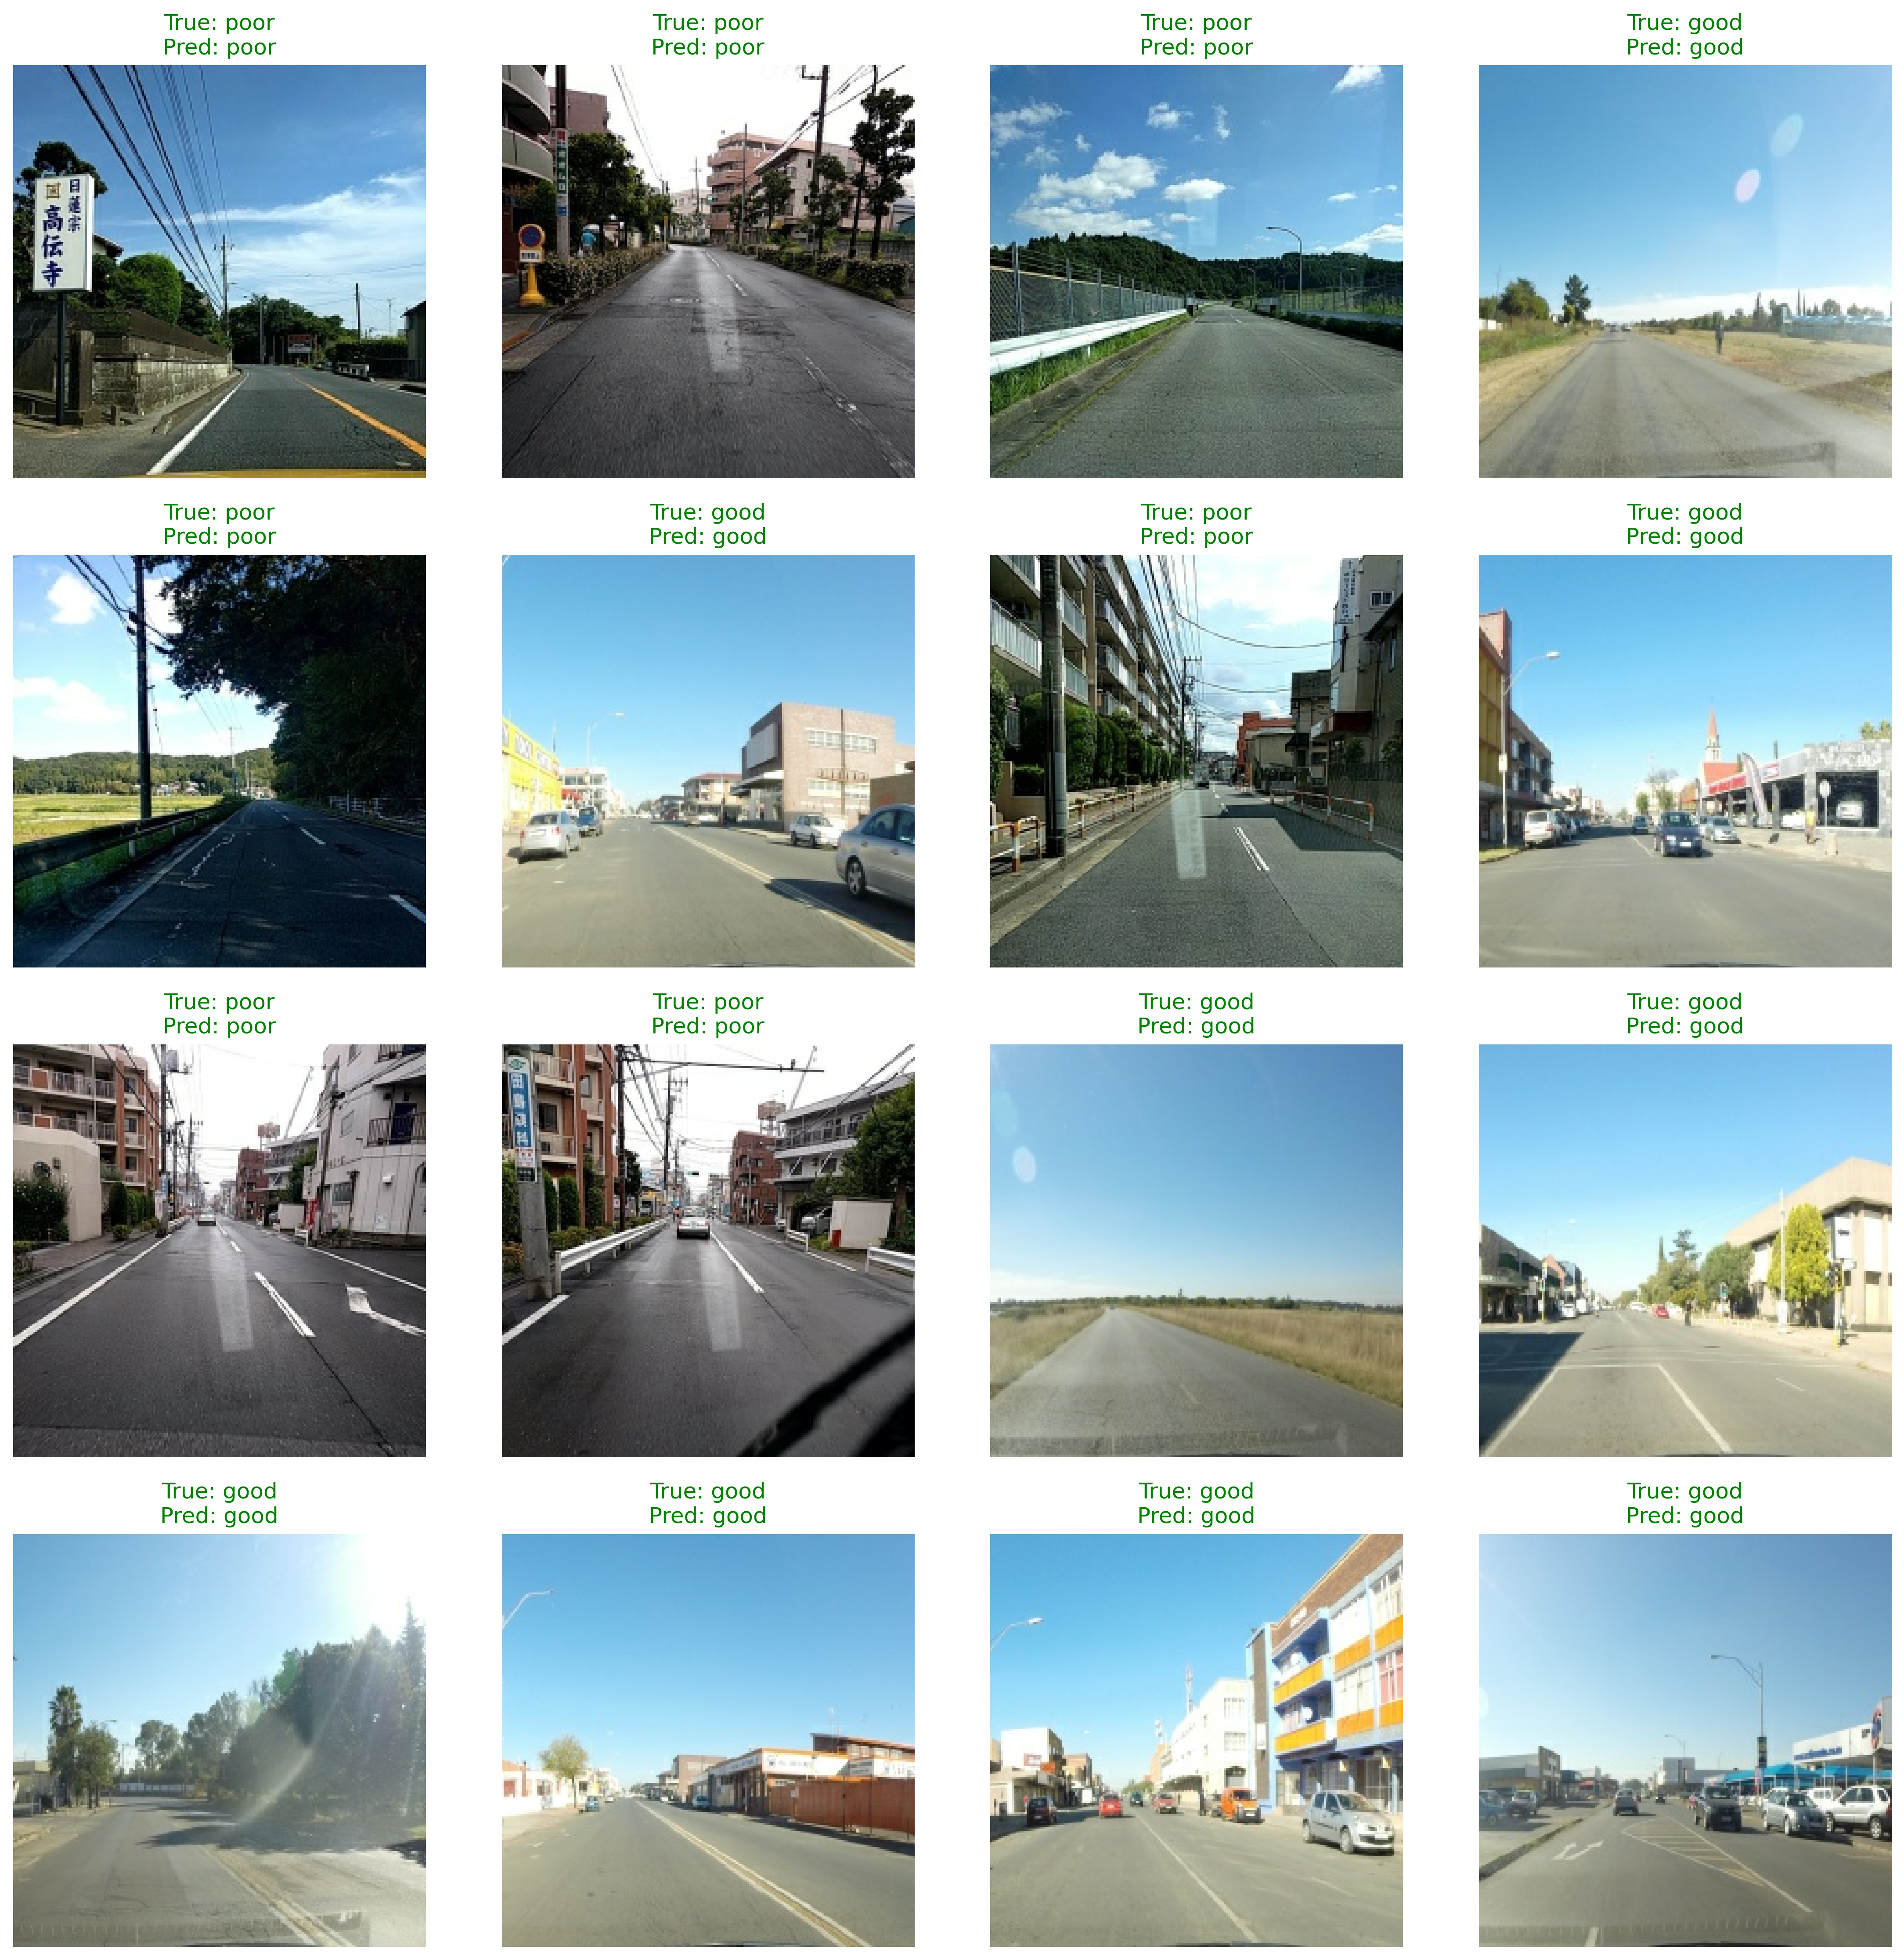



Visual Evidence
Visual Confirmation: This grid displays a random batch of images from the test set with their classifications.
Flawless Batch: Every sample shown here was correctly classified, indicated by the matching "True" and "Pred" labels in green.
Handling Variance: The model successfully identifies "Good" and "Poor" roads despite challenging conditions like strong shadows (bottom left), bright lens flare (bottom right), and complex urban backgrounds.
Clear Distinction: Notice the model accurately distinguishes between smooth asphalt ("Good") and textured, patched, or cracked surfaces ("Poor").

Slide 12


Future Work
1
Real-time deployment on video streams
2
Transfer learning with pre-trained architectures
3
Data expansion
Incorporate more diverse roads, seasons, and geographic regions to increase domain generalization and reduce dataset bias.
Extend from static image classification to frame-wise or sequence-based inference on dashcam or roadside camera feeds, enabling continuous monitoring and online alerts.
(e.g., ResNet, VGG, EfficientNet) to exploit richer feature extractors and potentially improve robustness under varying weather, lighting, and camera viewpoints.

